Slide 1

IntelliView
Artificial Intelligence Student Collective (AISC)
05/27/2025
Your AI Interview Assistant

Slide 2
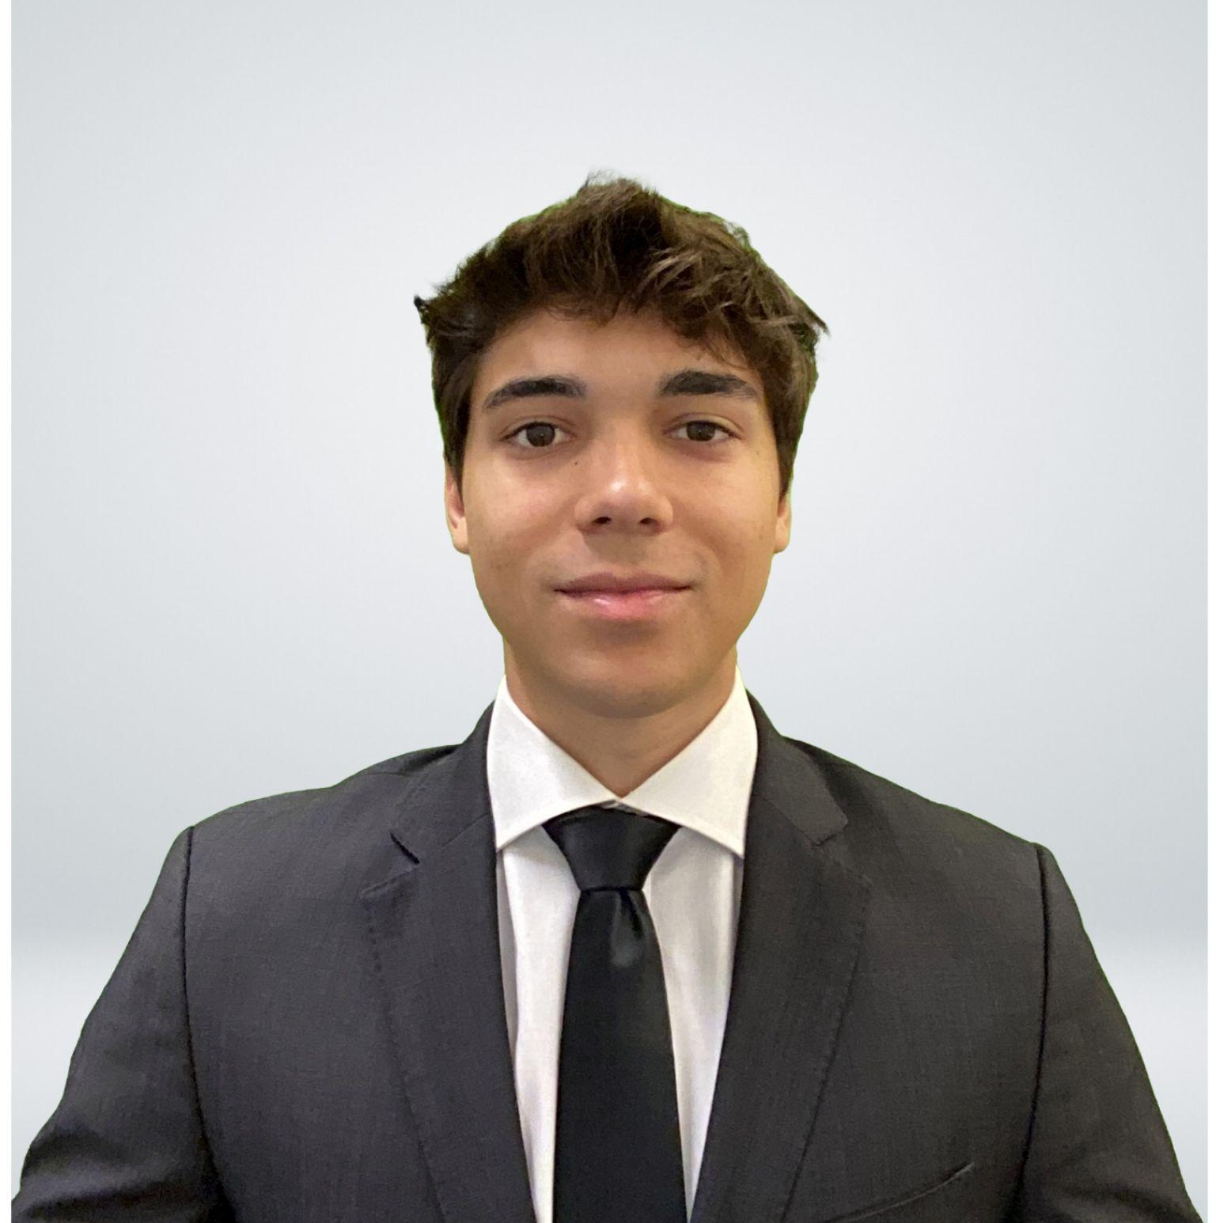




Meet our team!
Lauren Gallego
Alfonso Mayoral
Pedro Tajia
Junior Data Science & Engineering
Senior Telecommunications Engineer & Computer Science
Sophomore
Data Science

Slide 3
MEET THE PRODUCT
1

Slide 4

Overview & Key Features
1
2
3
4
5
Face Detection
Emotion Detection
Speech-to-text Transformation
LLM Report Generation
Real Time Analysis
A fine-tuned YOLO lightweight model is capable of drawing a bounding box over the user’s face
A second fine-tuned YOLO model is able to very accurately classify the user’s emotion from their facial expressions
Integrated Whisper model takes real-time audio and transcripts it into text form. This information is later used.
Using the logged emotions and transcripted text, an LLM model generates a formatted report of the interview.
Our application is able to do this in real time, with minimal latency that does not sacrifice any performance. This was one of the features that we prioritized.

Slide 5


Target audiences
Employers
Candidates
Employers can use IntelliView to keep track of different candidates for different job positions using an independent automatic system.
Candidates can use this tool as a practice tool to improve their interviewing skills, one of the main concerns of young potential candidates in today’s market.

Slide 6
GOING INTO SPECIFICS
2

Slide 7
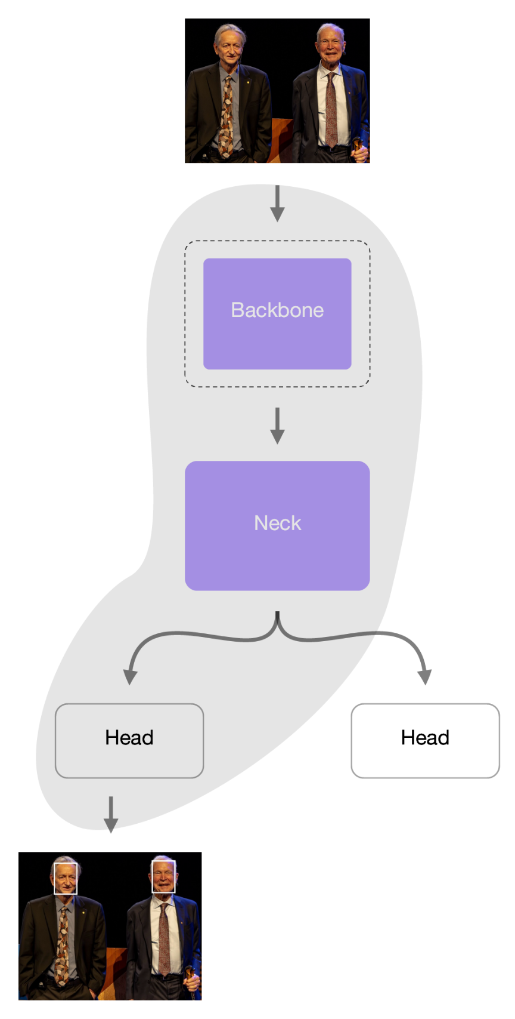
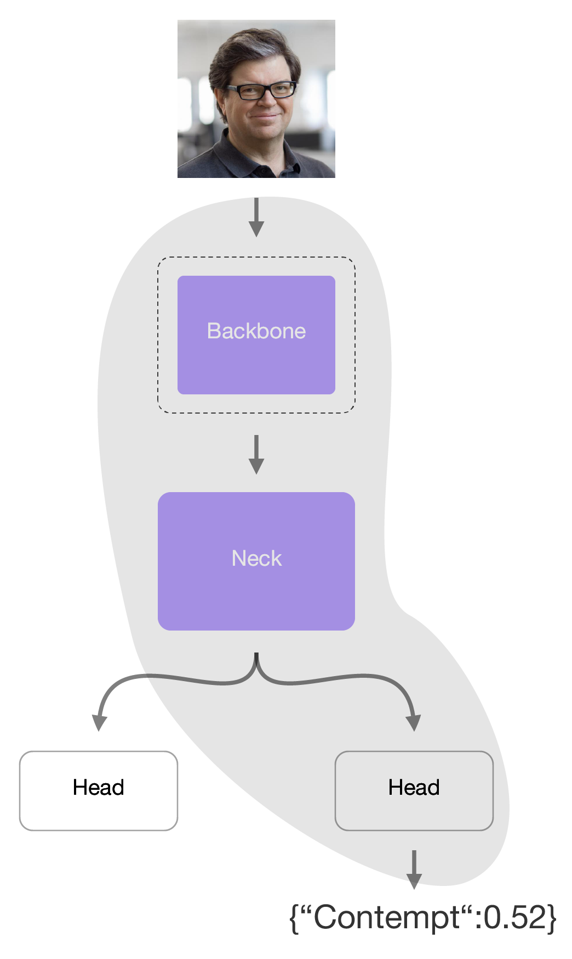
First Iteration
Have a system that detect a face and their emotion
Use a single yolo model, trained on two different datasets from kaggle.
Facial Expression Image Data AFFECTNET YOLO Format
Face-Detection-Dataset
Problem:
Catastrophic forgetting
Mismatch in the data

Slide 8
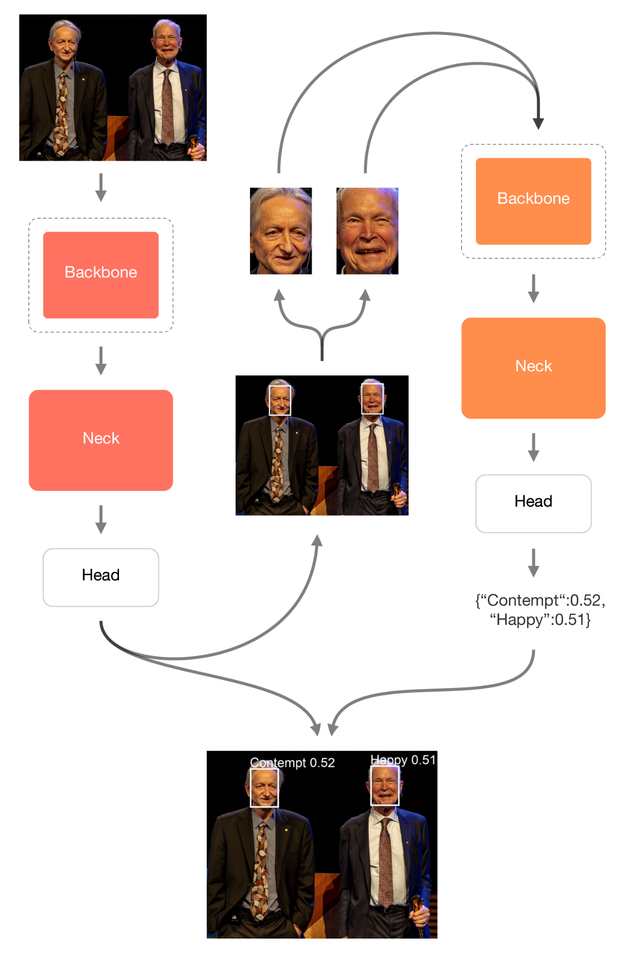

Final YOLO System
YOLO mode for face detection:
YOLO mode for emotion detection:

Slide 9
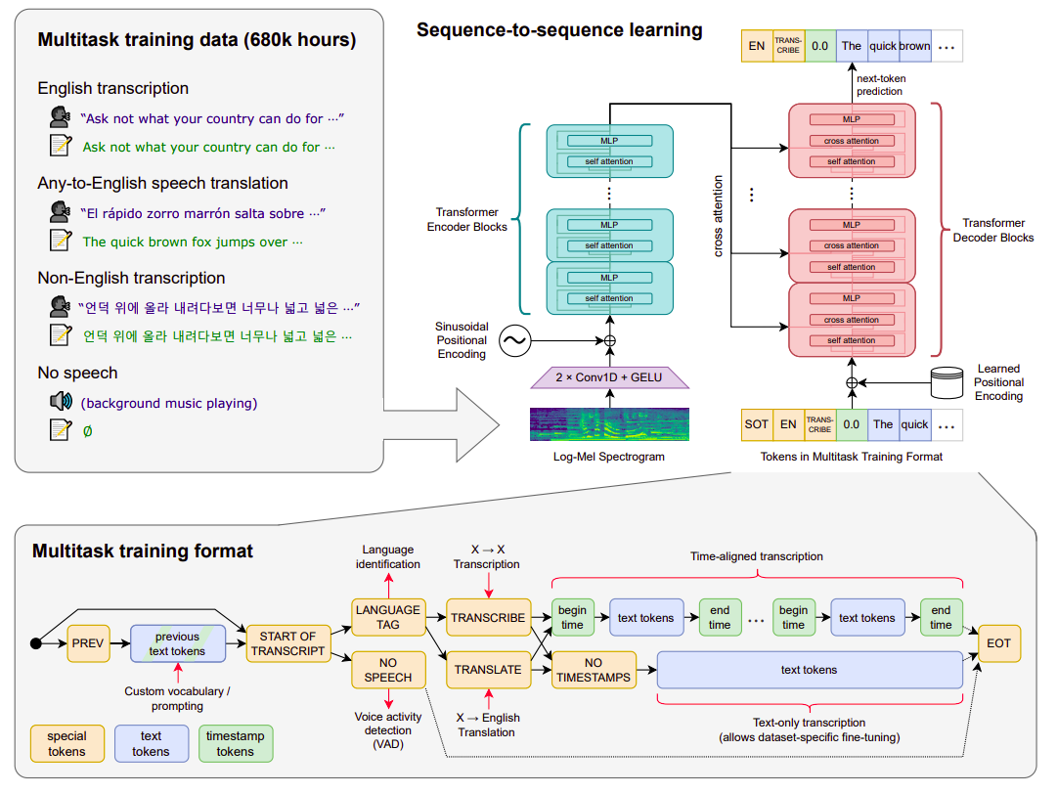
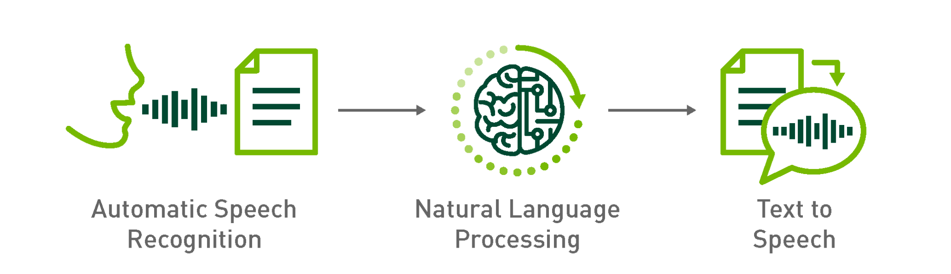
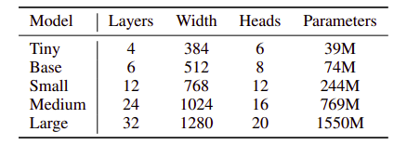
Real-time Speech to Text Capture
WHISPER
OpenAI’s open-source Transformer trained on 680 000 hours of noisy, multilingual audio. This model listens, transcribes, and even translates speech in almost 100 languages as it happens. It outputs text tokens that carry 20 ms-resolution timestamps, so every word can be anchored to the exact video frame in which it is spoken, giving us an airtight bridge between sound, vision, and downstream analytics.
Whisper Official Paper
Notes:
Whisper: Real-Time Multilingual Speech-to-Text Engine
OpenAI’s open-source Transformer—trained on 680 000 hours of noisy, multilingual audio—listens, transcribes, and even translates speech in almost 100 languages as it happens. It outputs text tokens that carry 20 ms-resolution timestamps, so every word can be anchored to the exact video frame in which it is spoken, giving us an airtight bridge between sound, vision, and downstream analytics.
Real-time audio-video capture with Whisper Our platform records the microphone and webcam streams simultaneously, then feeds the raw audio straight into Whisper. Because the model begins emitting text tokens roughly two-tenths of a second after speech onset, captions appear almost live on-screen while the camera continues filming. Each token is stamped with its precise moment in the recording, letting us line up words with frames, identify who is speaking when, and later correlate facial expressions with specific phrases.
A lightning tour of Whisper’s history Whisper grew out of OpenAI’s earlier audio experiments—WaveNet for speech generation and Jukebox for music modelling—where they learned to scale up datasets and Transformer capacity. In September 2022 they bundled that know-how into Whisper, releasing five model sizes (tiny to large) under an MIT-style licence together with the 680 000-hour training recipe. Within months, developers ported it to ONNX, CoreML, WebGPU, and even browsers, turning Whisper into the de-facto baseline for open-source speech recognition.
How Whisper works under the hood The incoming waveform is first converted into a log-Mel spectrogram, then compressed by two quick Conv1D-plus-GELU layers. A stack of Transformer encoder blocks builds a language-agnostic acoustic representation, which is passed through cross-attention to a Transformer decoder. The decoder produces a sequence of special symbols: a start-of-transcript token, a language tag, a task tag (“TRANSCRIBE” or “TRANSLATE”), millisecond-accurate timestamp tokens every 20 ms, the regular text tokens, and finally an end-of-transcript token. Because Whisper was trained on four interleaved tasks—English transcription, speech-to-English translation, non-English transcription, and pure background-noise clips—it learned to identify languages, detect voice activity, and handle noisy recordings without any extra tuning.
Why Whisper is exactly what our project needs Those design choices map neatly onto our requirements. Live captions for multilingual meetings drop straight out of the model, with automatic language detection switching tongues on the fly. The 20 ms timestamps let us export perfect SRT or VTT subtitle files and drive word-level search inside recordings. Since the weights are open, we can quantise the smaller variants and run them entirely on mobile devices, satisfying privacy constraints by keeping raw audio off the cloud. Finally, the robustness Whisper gained from its 98-language training mix gives us an excellent starting point for low-resource dialects; if we still need extra accuracy, we can fine-tune on our own accent-rich data rather than building a recogniser from scratch.
With Whisper as the backbone, our system gains real-time, multilingual, and privacy-friendly speech intelligence—shrinking development timelines while expanding what users can do with their recorded conversations.

Slide 10








LLM-Powered Interview-Report Agent
1. Import interview transcript
5. LLM refines summary
6. Assemble final report
4. Draft summary template
2. Clean & timestamp rows
7. Export TXT / MD / HTML
3. Extract candidate information

Slide 11

Evolution of agent development
1º Phase
2º Phase
Final Phase
Advanced models (beginning of the project)
Advanced models (beginning of the project)
Mid-size & Tiny Open Models + Heavy Prompting
Search-Augmented Phi-1.5 (Current)
Models
Models
Models
OpenAI GPT-4 Turbo 128k
Mistral-7B-Instruct-v0.2
Llama 3-8B-Instruct
BART-Large-CNN SAMSum (Philschmid)
Llama-2-7b-chat-hf
Microsoft Phi-3-mini-4k-Instruct
Google Gemma-2B-IT
Microsoft Phi-1.5 + in-process keyword search functions
Advantages
Advantages
Advantages
≈ 20 s end-to-end thanks to regex-first extraction, strict 20 s summary timeout and 4-/8-bit quantisation.
Runs on laptop CPU / 4GB GPU in harmony with the web app and the others models
Rich, human-like narrative that impressed recruiters.
Could digest full 2-hour transcripts without trimming.
On-prem GPU deployment slashed cost ≈ 75 %.
Tight prompts enforced consistent section headers.
Disadvantages
Disadvantages
Disadvantages
10 minutes average latency for free models due to computational cost
$0.50 + per report with GPT-4.
Very high computational and token cost
Candidate-info extraction + external search added ~ 4mins, so overall latency stayed ≈ 7mins.
Language felt formulaic; occasional factual slips.
Summary prompt must be extremely precise
Narrative less rich and creative than advanced models
100–150-word limit and template fallback
Next Steps:
Next Steps:
Next Steps:
Cut latency & cost while keeping acceptable quality.
Target on-prem inference to satisfy data-sovereignty rules.
Embed fast, in-process keyword search functions to grab candidate facts and eliminate network lag; fold retrieved snippets straight into the prompt.
Boost narrative quality without hurting speed.
Fine-tuning or In-Context Learning
Use advanced models and send notification via app when report is ready

Slide 12
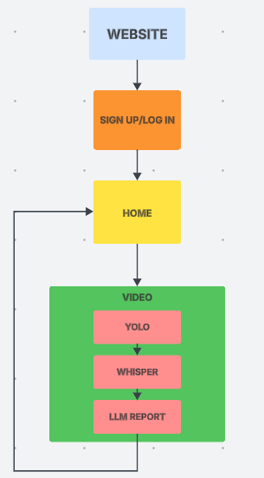



Website architecture
Step one
Secure user integration using hashed passwords in order to create a personalized home page. Passwords have to satisfy a series of security conditions to be validated.
Step two
Access your own personal home page. In there you will be able to access, modify and delete your reports. These will be ordered by
Step three
Go into video, press ‘Start Recording’ and begin your interview!
Once you are done, press ‘Stop Recording’ and wait a couple of seconds for your automatic report to be generated
1
2
3

Slide 13
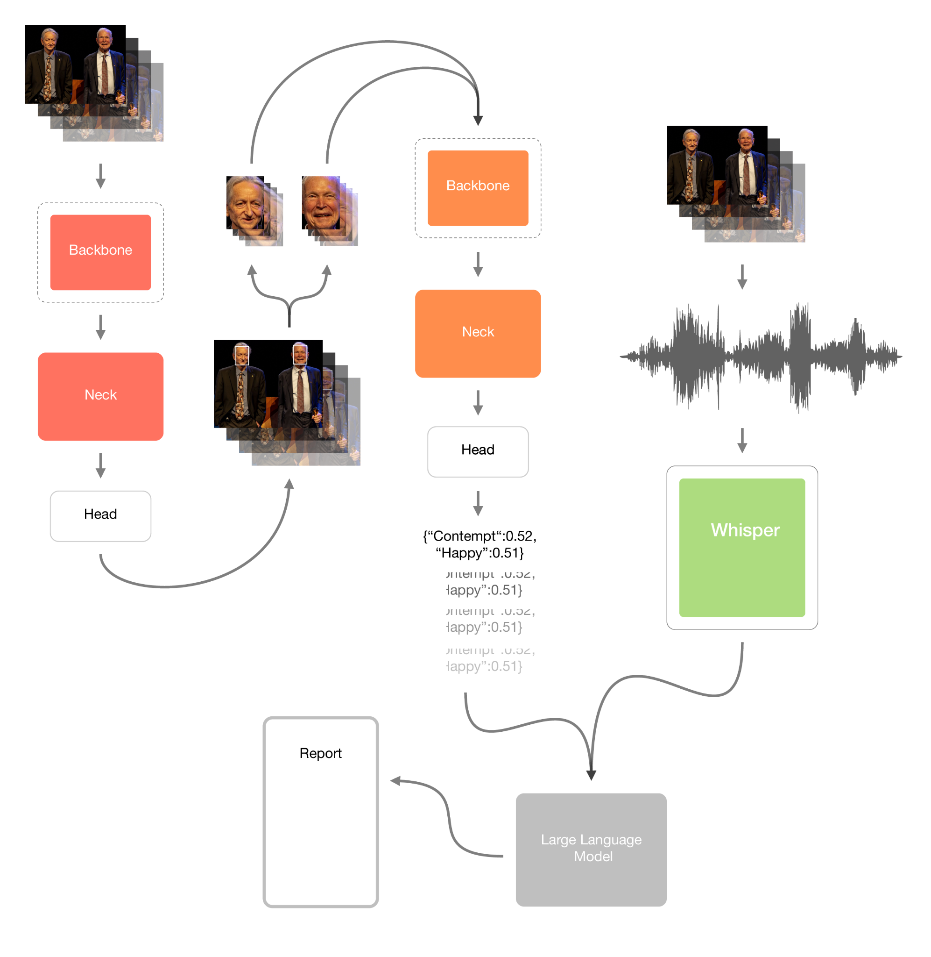

Slide 14
IT’S TIME TO DEMO!
3

Slide 15
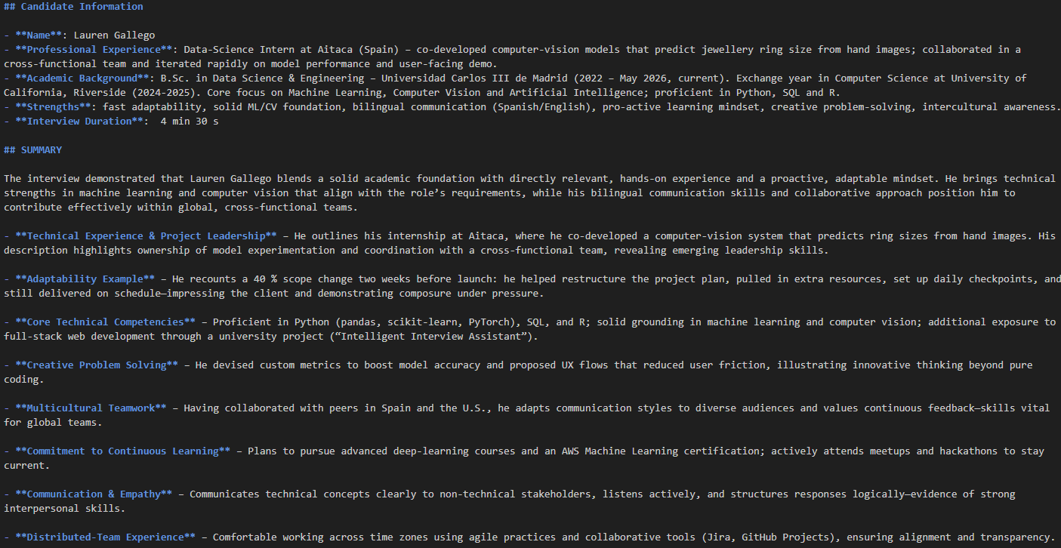
Comparison of Tested Models' Results (Llama 3 8B)

Slide 16
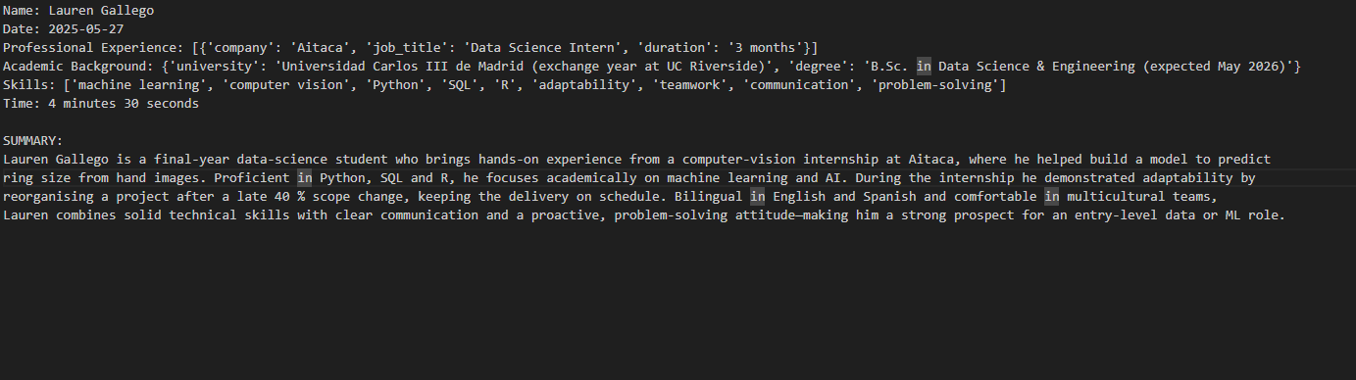
Comparison of Tested Models' Results (BART-Large-CNN SAMSum)

Slide 17
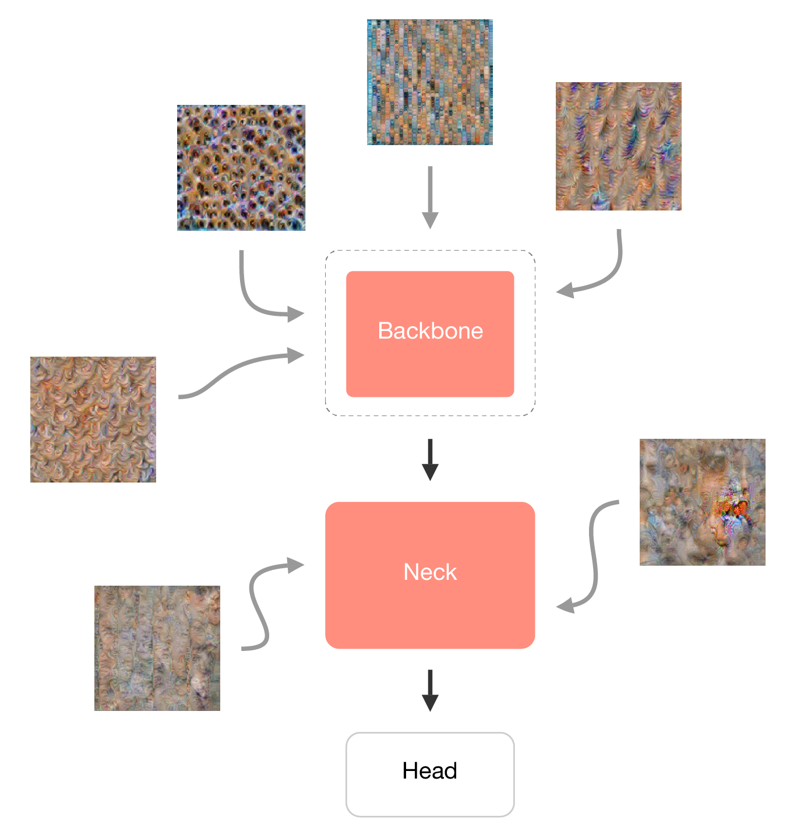
AI Interpretability
Understand the complexity of neural networks
Building Trust and Confidence
Mitigating Bias
Feature Visualization - Distill

Slide 18
Next Steps & Improvements
Run web application in a server
1
Use Whisper large models (1.55 B) for multilingual transcription
2
Use a more complex LLM that adapts to more open conversations
3
Create a more sophisticated web design
4
Train our own Emotion Classificator
5

Slide 19
ASK US ANYTHING!!
5

Slide 20



